Slide 1
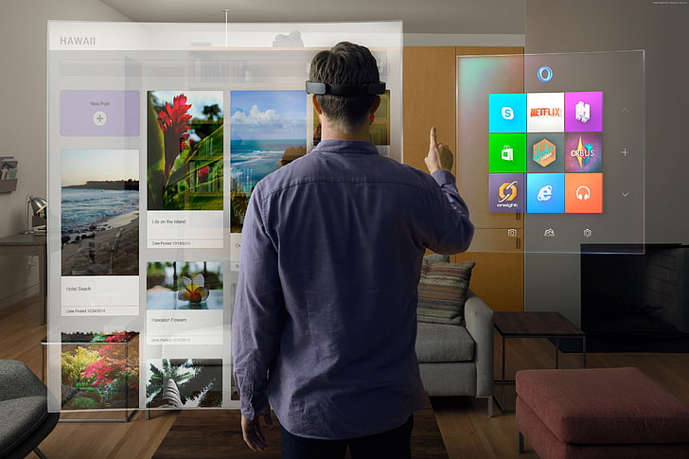
Augmented Reality based application for fashion and beauty makeover. Guide:- Prof. Seema Chandak
Group Members: -
33210 - Omkar Bhope 33235 - Parimal Mahindrakar
33246 - Tanishk Rane 33260 - Arnav Tope

Slide 2
Purpose:-
During the days of lockdown the industry which suffered the most was the fashion industry. The main cause of this fall in the sales of this industry was the lack of physical visibility of the product. Although many people buy products from online platform still there is a large group of population which prefer to buy the product after trying it out. Our aim is to make a platform that will bridge the gap between physical and virtual shopping by using augmented reality. The final objective is to create an interface in which the buyer can try-on the product virtually but will get a feel of reality such as virtual makeup, jewellery , t-shirts, watches etc.

Slide 3
Scope & Objective:-
The application will be completely deployed on cloud service such as azure/aws.
It can be accessed from everywhere in the world.
The application can also be remotely installed on small devices such as jetson nano for commercial and offline usage.
The app will give real-time rendering of AR products which will enhance the user experience.
The app will also provide smart assistance with the help of recommender system.
The usage of the app is not desktop specific but can be used from any smart device such as smart phone/tablet/ipad/desktop/laptop.

Slide 4
Abstract:-
With the large-scale virtualization of essential and non-essential services in today’s world, it has become imperative to develop an efficient and all-round online shopping system which stimulates the shopping experience while avoiding physical contact. The current pandemic situation has forced us to think of innovative methods to stimulate physical contact using various virtualization techniques, and through that we have devised a real-time online shopping tool, which while most importantly helping the customer avoid physical contact, still provides him/her with a near-identical shopping experience. Through augmented reality techniques like facial landmark detection, pose estimation and 3D modelling, we can replicate the appearance of various clothing accessories on the customer in real-time, essentially stimulating the entire physical experience of shopping. Furthermore, we will be integrating machine learning into this project as well. First and foremost, we will be using a facial expression recognition system to gauge the emotional reactivity of the customer to a certain product. These reactions will act as automatic feedbacks, which apart from internal use, can be fed to an innovative recommendation system. Through this system we can use these facial feedbacks extremely effectively for recommendation and marketing purposes. Therefore, using a combination of augmented reality and machine learning techniques, our project aims to provide the customer with a holistic online shopping experience which parallels a physical experience for the same.

Slide 5
Methodology :-
The system will use the FER dataset for the successful capture of the human expressions which will be followed by the prediction of appropriate products for the customer by the recommender system.
The recommender system will use the Dense Fashion dataset combined with the custom-made jewelry and makeup shade dataset.
The face landmarks will be obtained with the help of MediaPipe face mesh algorithm.
For the clothing section the DenseFashion algorithm will be used, it gives the complete mask along with the important coordinates which will help us to accurately choose and overlay different types of clothing on the user.
The system will use Figma 3D modelling technique for the virtual jewelry simulation. Because of the software being flexible and the ability to create and render custom models free of cost we have decided to go for figma.

Slide 6
Hardware & Software Requirement:-
Offline Approach :-
Online Approach :-
Hardware
Display Device
Jetson Nano / CPU
Internet connection
Camera
GPU
Software
Python
React/Angular
OpenCV
Pytorch
Mediapipe
Cloud
Azure VM 4GB Ram
Netlify
Azure ML Services
Device
Laptop/ Desktop/
Android/ iOS
Software
Python
React/Angular
OpenCV
Pytorch
Mediapipe

Slide 7
Modules Used :-
Python -
Opencv
Dlib
Pytorch
Mediapipe
Numpy
Pandas
Tensorflow-keras

Slide 8
Proposed system:-
Our proposed system will include camera as a hardware (Attached with Phone/Laptop/PC) for capturing emotion recognition and creating 3D modelling of faces and applying external filters which will mainly contain jwellary, earrings, lipstics, etc.
The user interaction will be through a website where he/she will choose a product. As he/she watches a product, we will recognize his/her emotion whether he/she liked that product or not. Based on emotion recognition, we will recommend best product to user.
Also if user wants to check how the products looks by realtime, then our website will also creating 3D model of face. After creating the 3D model, he/she can try out jwellery, etc on it.

Slide 9
Outcomes:-
Best user interaction
3D modelling
Emotion detection
Recommender system
Data Security
REST API integration

